Slide 1
New AiGe Banking
Abboud Beroual, Minh Thuan Huynh,
Kaïna Benhammou, Ahmad Saad

Slide 2
Contents
01 | Introduction and Mandate
02 | Analysis
03 | Recommended Strategy
04 | Implementation Plan
05 | Projected Outcomes
06 | Conclusion

Slide 3
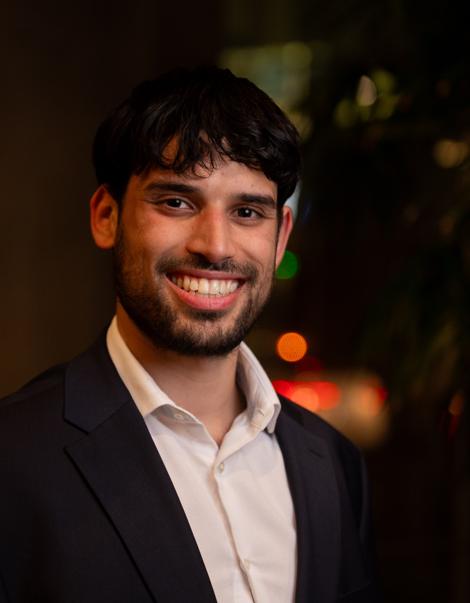

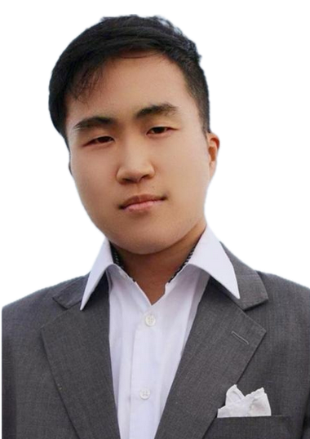
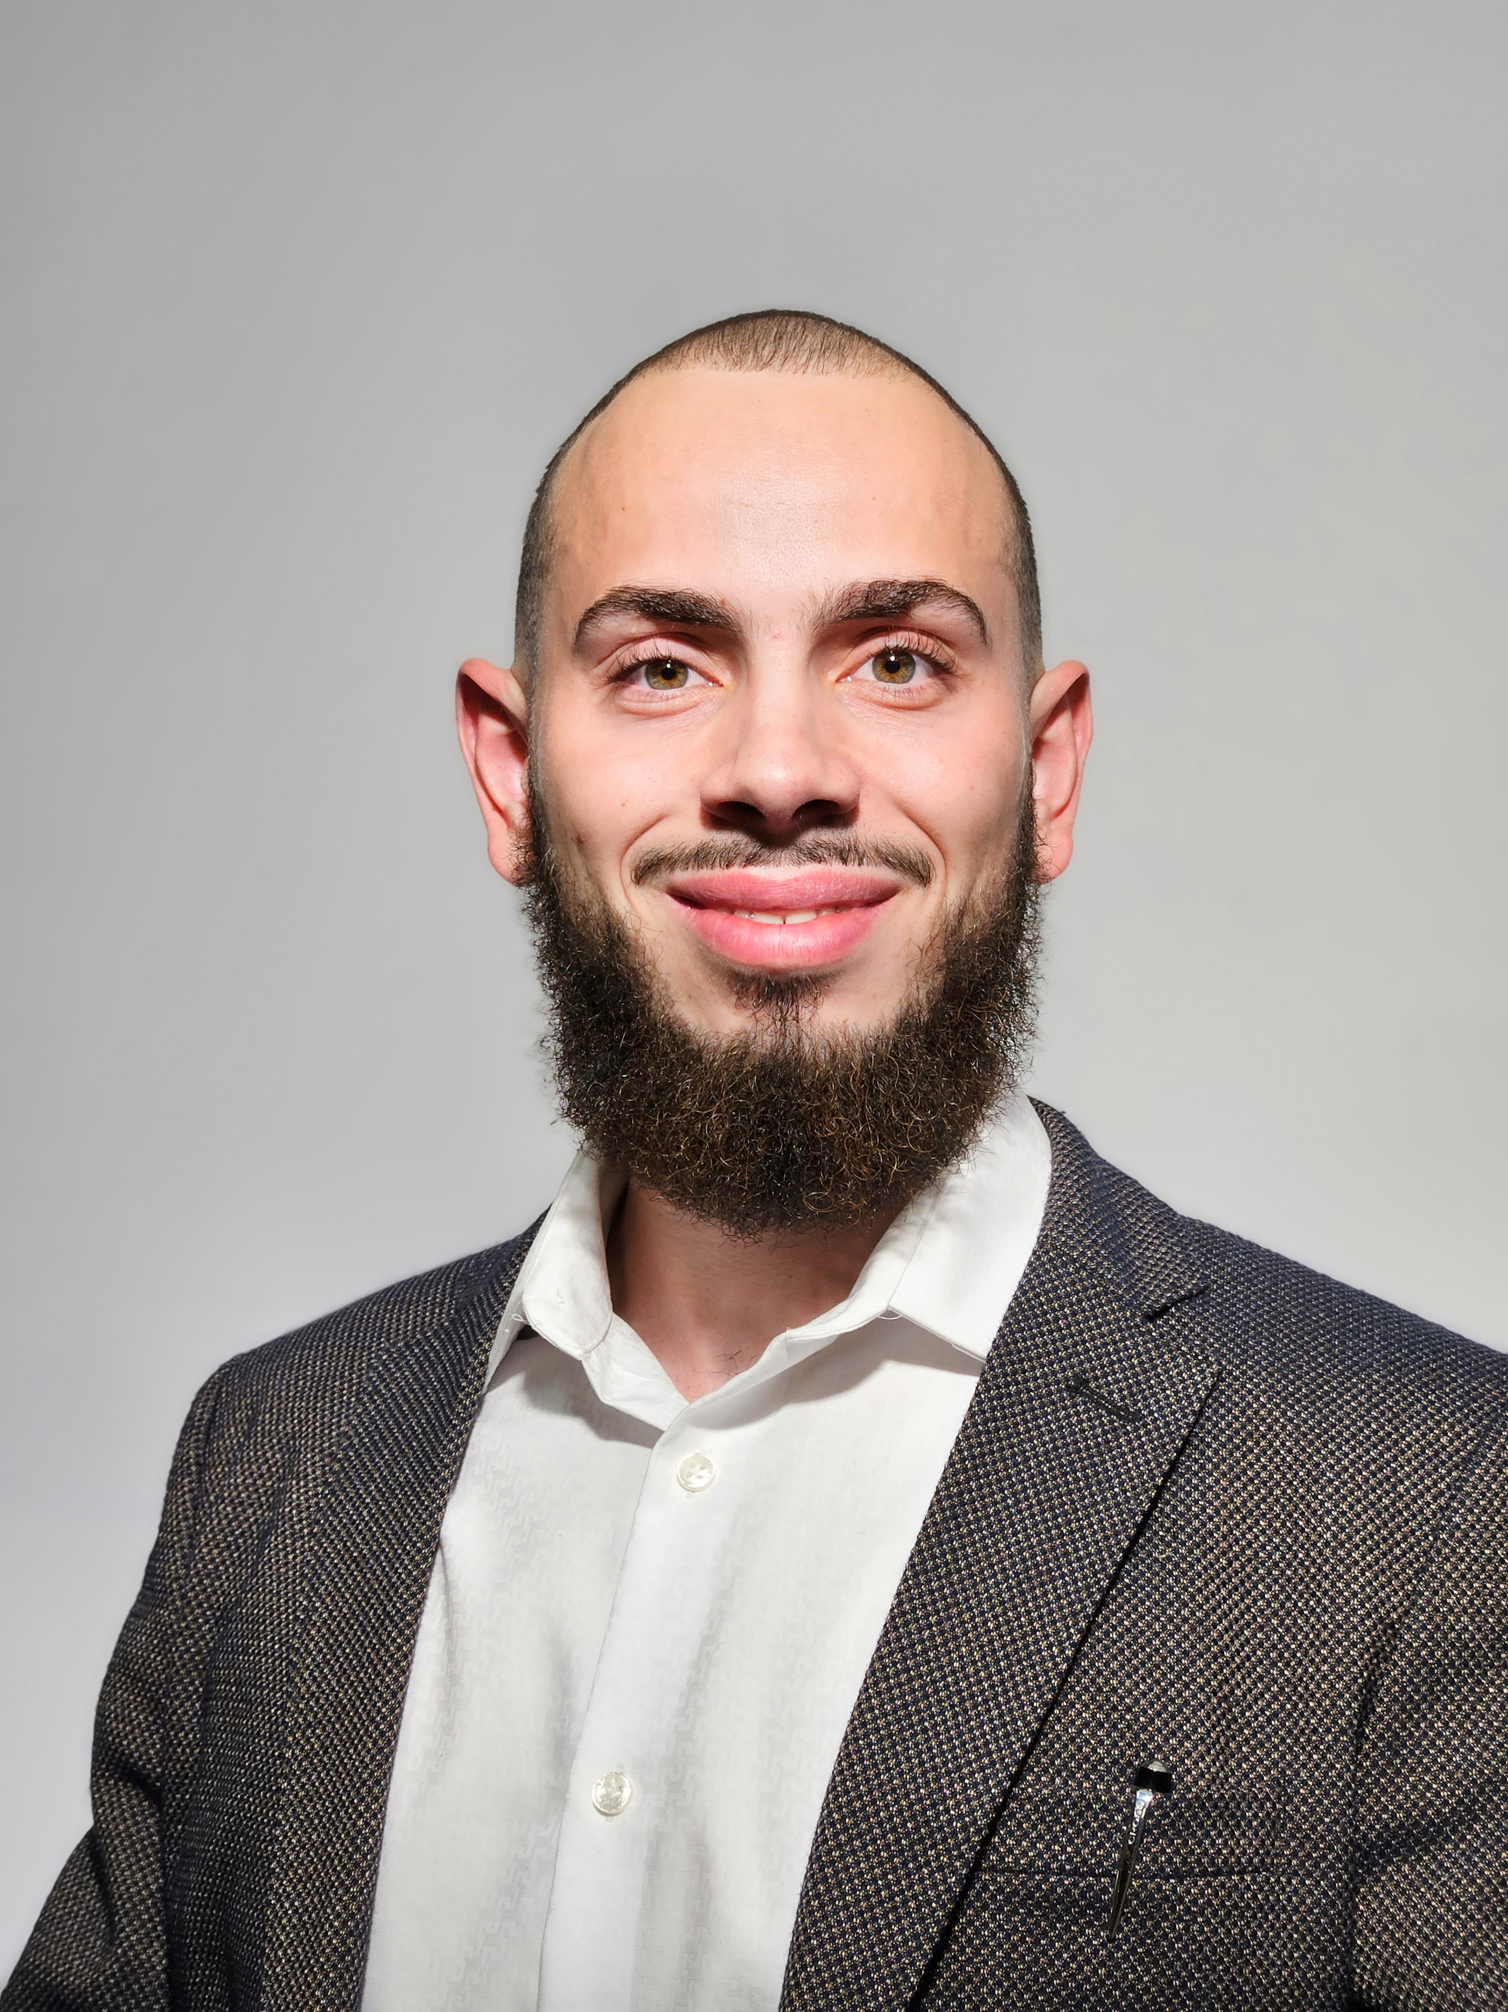
Our Team
Abboud B.
Analyst
Ahmad S.
Analyst
Kaïna B.
Analyst
Minh H.
Technical Analyst

Slide 4
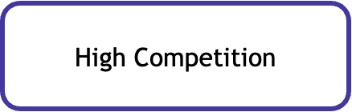

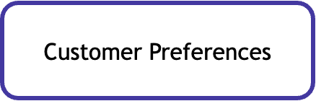
Why are we here for today ?
How can Sentinel implement an AI-driven digital banking strategy tailored to the Montreal market ?
Mandate
Key Considerations
New AiGE of Banking
Strategy
The Montréal banking industry will be transformed with new solutions and a new planner
Impact

Slide 5
Analysis
01
An overview of Montreal’s financial and banking market, infrastructure, and landscape

Slide 6
Montreal has a vibrant and growing banking landscape rooted in centuries of Quebec history, making it a viable option for an expansion
% of branches open in Montreal as of October of each year Customer landscape in the Canadian banking industry
1018
973
958
60%
60% of Canadian banks are anticipating increased pressure to adapt to changing customer preferences in the next three year (PwC's Global CEO Survey, 2024)
957
950
41,988
attacks
Cybersecurity remains a critical concern as banks adopt more digital solutions this year (Canadian Anti-Fraud Centre, 2023).
2019 2020 2021 2022 2023 65
​
(Canadian Bankers Association, 2023)
8
Eight Canadian banks are members of the Net-Zero Banking Alliance, leading banks to align their financial activities with net-zero emissions by 2050
8
8
1.5%
6.6%
48%
48% of respondents visit their branch less than twice per year, 52% visit their branch once a month or once every few months (KPMG, 2024).
In Québec, real GDP growth is expected to reach 1.5% in 2025 (Finances Québec, 2024).
Purchasing power per capita has improved considerably between 2018 and 2023 (Finances Québec, 2024).
Insight: Banks must prioritize rapid, user-friendly digital services that align with the fast-paced lifestyles of modern consumers.
Insight: As media consumption habits shift, banks need to embrace innovative and interactive digital solutions to capture and maintain customer interest.

Slide 7
Recommended Strategy
02
Recommendations sourced from leading information and cutting-edge technology

Slide 8
Possible solutions
Chatbots for Customer Service
Credit Risk Management
Personalized Offers
Fraud Detection Automation
ML for risk.
Accurate, dynamic rates.
Faster decisions, fewer defaults.
Bias, complexity, security.
Personalize offers.
Boosts satisfaction, loyalty, revenue.
Data use concerns, quality, compliance
Automated common inquiries.
Reduces costs, boosts efficiency.
Faster, 24/7 response.
Limits with complexity, updates needed.
Real-time fraud detection.
Suspicious activity blocking
Security, cost reduction.
False positives, updates.
03

Slide 9

1. Market Entry
Low Prices + Marketing
Objectives
Attract customers in Montreal with reduced fees and a strong marketing campaign.
Benefits
Lower fees through AI-driven operational savings.
Targeted marketing to effectively reach key customer segments, driving growth.
AI Integration
AI-powered chatbots for 24/7 customer support, reducing operational costs.
AI-driven marketing to target specific demographics and increase customer acquisition.
Risks
Potential chatbot inaccuracies and frustration.
Data privacy concerns with AI-driven systems.
Challenges in maintaining sustainable low fees long-term.

Slide 10
2. Market Growth
Objectives
Differentiate Sentinel by offering innovative, personalized financial services tailored to customer needs.
Benefits
Appeals to tech-savvy, younger customers seeking customized experiences.
Differentiates Sentinel from competitors by providing more relevant and engaging financial services.
AI Integration
Personalized recommendations for loans, investments, and savings.
Risks
Bias in AI algorithms, potentially affecting fairness in decision-making.
Consumer privacy concerns related to data collection and usage.
Transparency issues: Need to ensure clarity on how AI-driven recommendations are made.

Slide 11

Sentinel: Don't Fly Too Close to The Sun

Slide 12
3. Ethical AI Use
Objectives
Ensure customer trust through ethical and transparent AI use, avoiding profiling and biases.
Benefits
Builds customer trust by ensuring fairness and ethical decision-making.
Enhances security through AI-driven fraud prevention.
AI Integration
Bias reduction: Avoid AI Credit Risk
Transparency: Transparent communication of where and how AI is used
Risks
Legal challenges if AI decisions are not transparent or if biases are detected.
Potential customer distrust if AI processes lack clarity or fairness..

Slide 13
4. Trust and Brand Confidence
Objectives
Reduce fraud risks and protect the brand by using AI to authenticate transactions and detect fraudulent activity.
Benefits
Protects customers and Sentinel from financial losses.
Preserves brand reputation by preventing fraud and responding quickly to threats.
AI Integration
Behavioral biometrics and real-time fraud detection powered by AI to monitor transactions and identify anomalies.
Risks
False positives could frustrate customers by blocking legitimate transactions.
Need for secure data management and strict privacy compliance to ensure effective operation.

Slide 14
Solution Architecture
New AiGE Plan

Slide 15
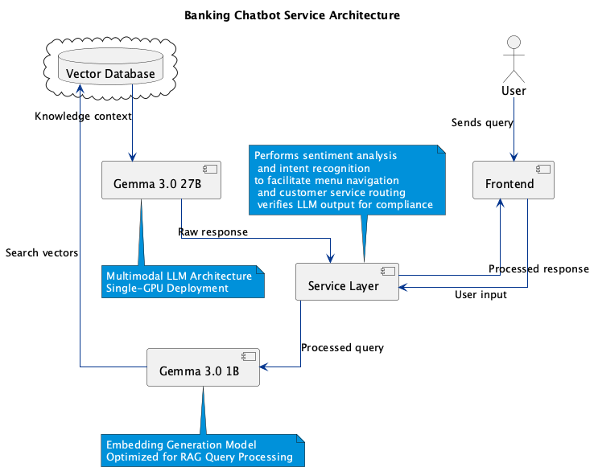
Chatbots for Customer Service
Compliance
Local deployment, Service Layer and RAG ensures privacy and accuracy
Intent Detection
Helps navigate menus and agent redirection saving time and resources
Cost Effective
Pretrained Transformers means we only need to fine tune and develop Service Layer
Sustainable
Gemma 3.0 can be run on a single GPU and ranks similar to Deepseek R1

Slide 16
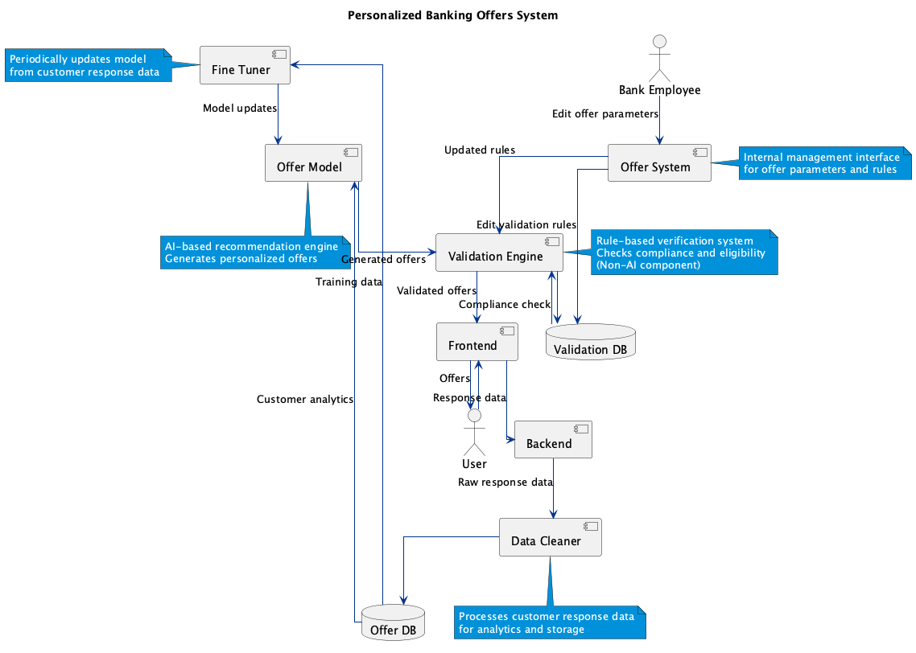
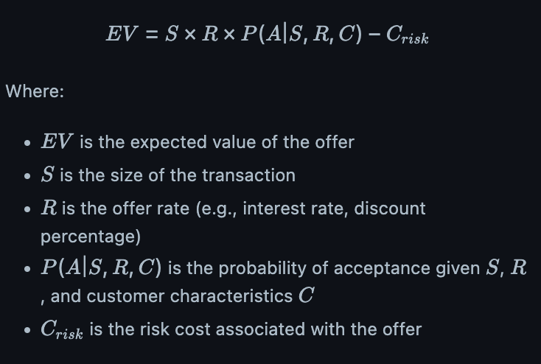
Personalized Offers
Basic Elements:
Validation DB stores business rules (upper/lower bounds)
Offer DB stores sanitized offer history (offerType, transactionAmount, revenueAmount, acceptanceStatus …)
Model optimizes for equation

Slide 17
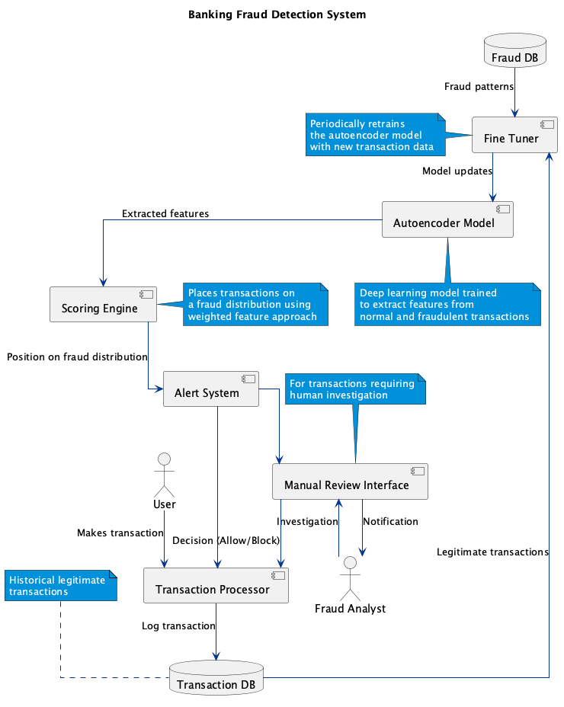
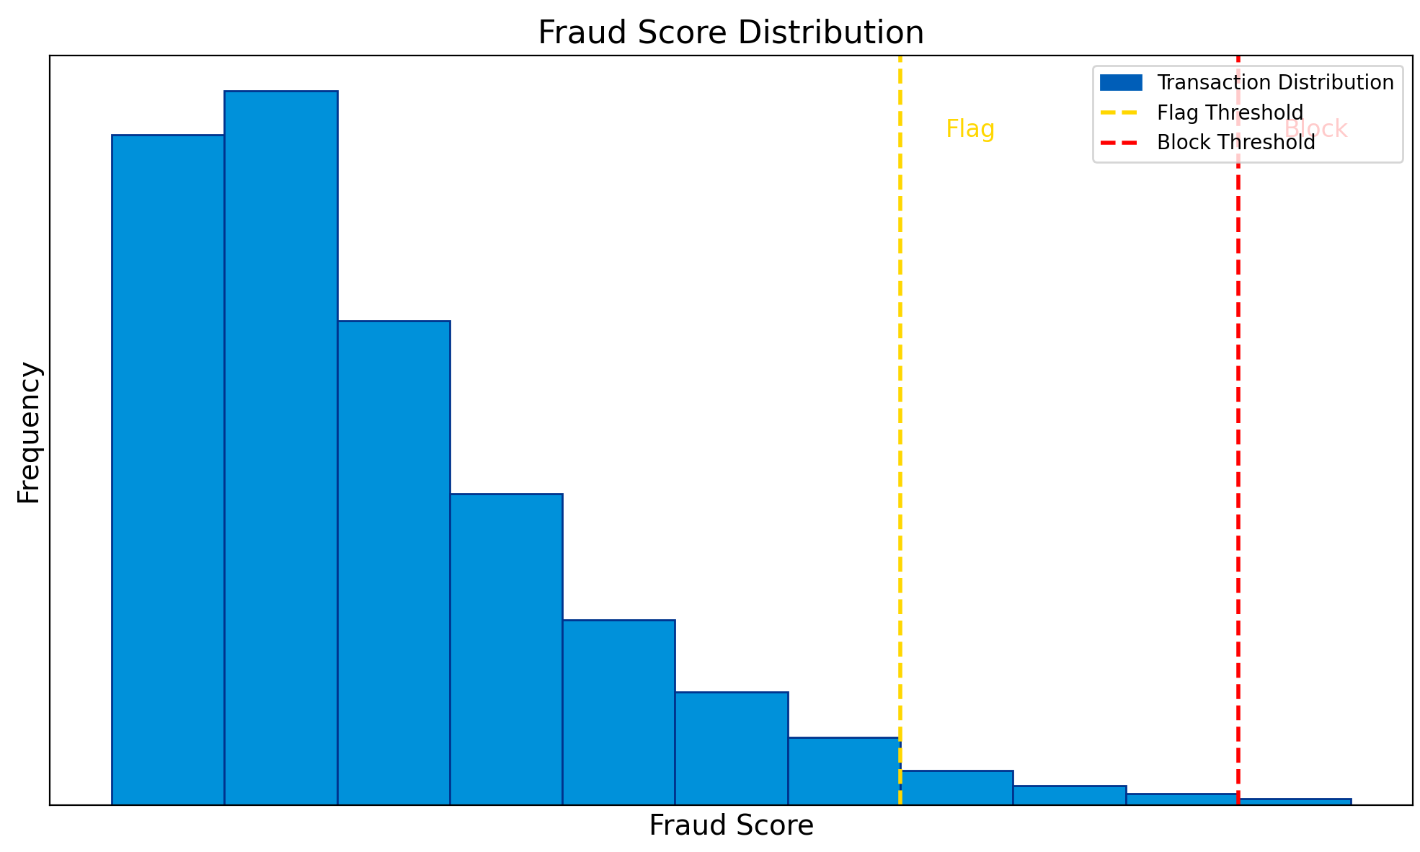
Fraud Detection
Autoencoder trained on fraudulent and legitimate transactions
Scoring engine
Stores probability distribution
Calculates Fraud Score

Slide 18
Implementation Plan
03
A comprehensive three-year implementation plan

Slide 19
Strategy implementation over a three-year timeline
Implementation
Y1, Q1
Y1, Q2
Y1, Q3
Y1, Q4
Y2, Q1
Y2, Q2
Y2, Q3
Y2, Q4
Y3, Q1
Y3, Q2
Y3, Q3
Y3, Q4
Branch
Openings
Chatbot
Integration
Personalized
Banking
Marketing
Automatic Fraud
Detection

Slide 20
Financial Outlook
04
An overview of Montreal’s financial and banking market, infrastructure, and landscape

Slide 21
Cost Breakdown: Automated Chatbot
 | Year | Year | Year
 | 01 | 02 | 03
Initial Development | 300,000 | 0 | 0
Infrastructure Cloud | 100,000 | 100,000 | 100,000
Maintenance and Updates | 50,000 | 50,000 | 50,000
Continuous Training | 30,000 | 30,000 | 30,000
Total | 480,000 | 180,000 | 180,000
 |  | 840,000

Slide 22
Cost Breakdown: Personalized Banking
 | Year | Year | Year
 | 01 | 02 | 03
Algorithm Development | 400,000 | 0 | 0
Infrastucture and Data Storage | 200,000 | 200,000 | 200,000
Maintenance and Optimization | 120,000 | 120,000 | 120,000
Compliance Management | 50,000 | 50,000 | 50,000
Total | 770,000 | 370,000 | 370,000
 |  | 1,510,000

Slide 23
Cost Breakdown: Fraud Detection Automation
 | Year | Year | Year
 | 01 | 02 | 03
Initial Development | 450,000 | 0 | 0
Infrastructure | 200,000 | 200,000 | 200,000
Maintenance and Updates | 80,000 | 80,000 | 80,000
Formation Continue | 60,000 | 60,000 | 60,000
Compliance Management and Audit | 75,000 | 75,000 | 75,000
Total | 865,000 | 415,000 | 415,000
 |  | 1,695,000

Slide 24
Why are we here for today ?
How can Sentinel implement an AI-driven digital banking strategy tailored to the Montreal market ?
Mandate
Key Considerations
New AiGE of Banking
Strategy
The Montréal banking industry will be transformed with new solutions and a new planner
Impact

Slide 25
Appendix
05
Resources, links, and reliable information for your convenience

Slide 26
Appendix 1: Links
https://www.bankinfosecurity.com/court-unitedhealth-must-answer-for-ai-based-claim-denials-a-27534
https://cba.ca/article/bank-branches-in-canada
https://www.ibisworld.com/ca/industry/quebec/commercial-banking/17348/
https://www.finances.gouv.qc.ca/Budget_and_update/maj/documents/AUTEN_updateNov2024.pdf
https://www.azeusconvene.com/articles/digital-transformation-in-banking
https://assets.kpmg.com/content/dam/kpmg/ca/pdf/2024/06/ca-banking-on-branches-en.pdf?utm_source=chatgpt.com

Slide 27
Appendix 2: AI Usage
Code helper for diagrams
Equations
Search helper
Used free plan of Chatgpt

Slide 28
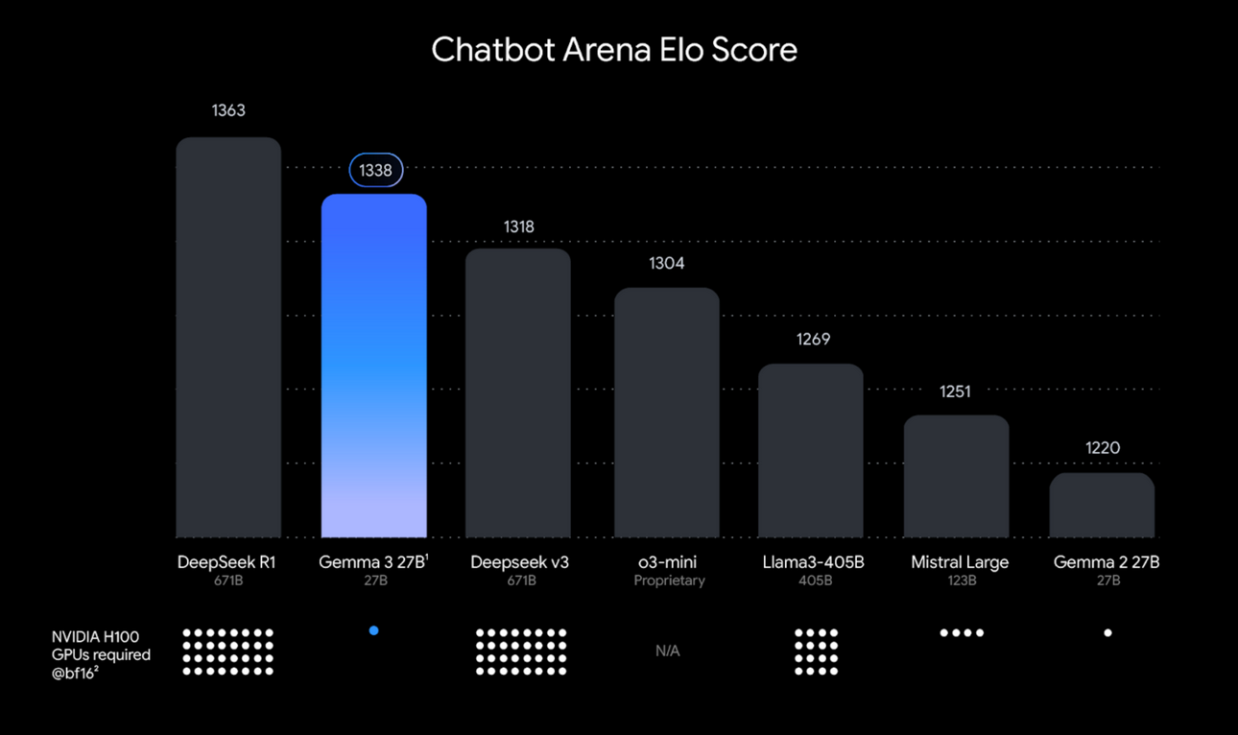
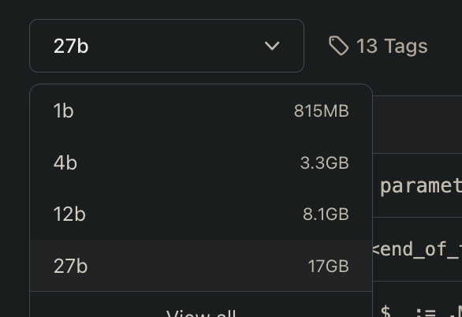
Appendix 3: Gemma 3.0

